Slide 1



Support Vector Machine And Neural Network Models To Predict Severity And Causative Factors of Accident In Nigeria
Construction and tuning of SVM and NN models for prediction and classification
11th December, 2023
www.alc.alueducation.com

Slide 2

AUTHOR
Ganiyat
Adekunle
STUDENT
Student Number: S2110996
Email:g.adekunle@alustudent.com
gadeku200@ac.caledonian.uk

Slide 3
Problem Overview
Severity of Road Traffic Accidents in Nigeria
Transportation and logistics are integral to society, but the rising trend of road traffic accidents (RTAs) in Nigeria poses a serious threat. With RTAs becoming the third-leading cause of death, accounting for trauma-related fatalities and the most common cause of disability, the situation demands attention. Nigeria records a concerning statistic of 1042 deaths per year per 100,000 vehicles, ranking high globally in road-related fatalities. This alarming prevalence in developing countries like Nigeria necessitates proactive measures for a safer transportation system.
Statistics
DEATHS PER YEAR
1042
DEATH CAUSE RANK
3rd

Slide 4
Data Exploration and Preprocessing
A.
Data Consolidation
D.
Identifying Patterns and Outliers
The road traffic accident and causative factors dataset gotten from the Nigerian Bureau of Statistics contain different tables with repeated columns. These tables were merged by the state column facilitating more effective predictive modeling with a streamlined and manageable structure
Python Libraries such as Seaborn, Matplotlib and Plotly were used to visualize the data so as to gain insights from the data and identify the patterns and outliers that will aid feature selection and model construction
C
B
D
A
The preprocessing was done iteratively.
E
E.
Data Augmentation and Integration
B.
Understanding the Data
PROCESS
The transport.csv and causativefactors.csv were merged together with the Pandas merge() function. The causativefactors.csv is the complementary dataset that was used to enhance the performance of the models. This can be seen in how the accuracy of the NN model became more realistic after changing the test data to the augmented dataset.
After the datasets were imported using Pandas and consolidated, Pandas functions such as info() were used to understand the dataset structure, type, number of rows and columns, sum of missing values, etc.

Slide 5
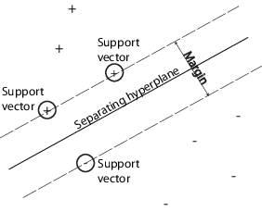
Model Construction and Tuning (SVM)
Construction:
Data Split: The dataset was divided into training and testing sets using the train_test_split function, allocating 80% for training and 20% for testing.
Kernel Selection: The choice of the appropriate kernel is crucial. Three types explored: Linear, Radial Basis Function (RBF), and Polynomial, each with distinct characteristics.
Tuning:
Hyperparameter Tuning: Systematically adjusted hyperparameters, including C (regularization parameter) and gamma (kernel coefficient), optimizing the model's performance.
Grid Search: Employed Grid Search to explore multiple hyperparameter combinations and determine the set that yields the best results.
Impact of Tuning: Tuning significantly influenced model performance, with notable improvements observed in metrics such as Mean Squared Error, Root Mean Squared Error, R-squared, and Mean Absolute Error. The process enhanced the SVM model's ability to capture patterns and make accurate predictions on the dataset.

Slide 6
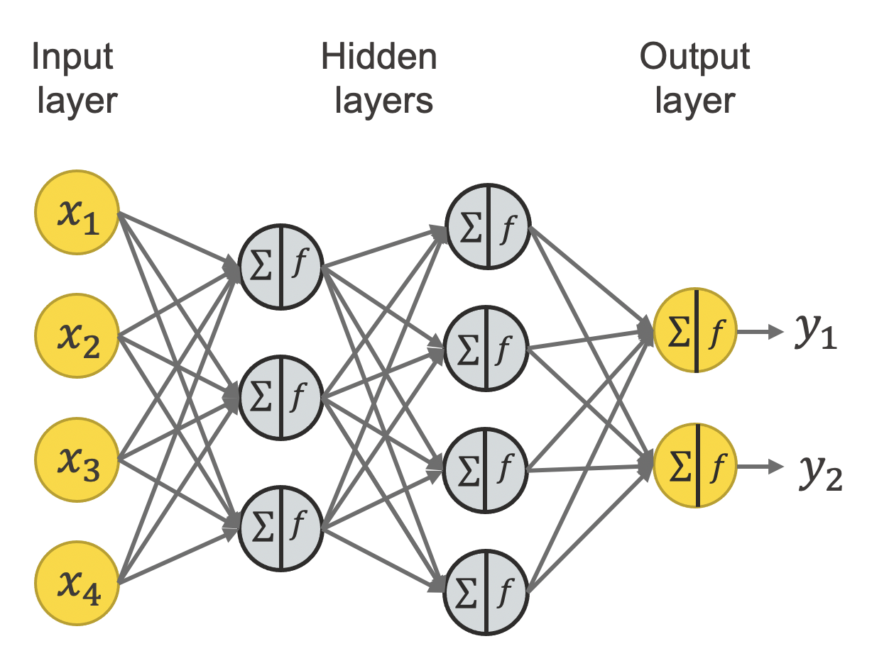
Model Construction and Tuning (Neural Network)
Construction:
Data Split: Utilized the train_test_split function to segregate the dataset into training and testing sets, allocating 80% for training and 20% for testing.
Model Architecture: Constructed a Neural Network with an initial architecture involving input, hidden, and output layers. Adjusted the number of neurons, layers, and activation functions to capture the dataset's complexity.
Tuning:
Hyperparameter Tuning: Focused on tuning critical parameters such as learning rate, batch size, and epochs to optimize the model's learning process and convergence.
Augmentation: Implemented data augmentation techniques to enhance the model's ability to generalize and recognize diverse patterns in the dataset.
Impact of Tuning: The tuning process led to significant improvements in the model's overall performance, as reflected in metrics such as Test Loss, Accuracy, Precision, Recall, and F1 Score.

Slide 7
Model Evaluation (SVM)
Metrics | SVM Model 1 (Linear) | SVM Model 1 (RBF) | SVM Tuned Model (Linear) | SVM Tuned Model (RBF)
Mean Squared Error | 0.62397 | 709377.32 | 0.62397 | 684615.95
Root Mean Squared Error | 0.78992 | 842.25 | 0.78992 | 827.42
R-squared | 0.999998 | -1.06535 | 0.999998 | -0.99325
Mean Absolute Error | 0.60402 | 631.10 | 0.60402 | 614.19
Evaluation and Comparison:
The linear kernel exhibits exceptional performance, showcasing minimal differences between the initial and tuned models.
RBF kernel's tuning led to a substantial reduction in Mean Squared Error, Root Mean Squared Error, and Mean Absolute Error, indicating improved accuracy and precision.
Tuning, especially in the RBF case, significantly mitigated the overfitting observed in the initial models.
The tuned models exhibit improved performance, particularly in the RBF kernel, demonstrating the efficacy of hyperparameter tuning in refining SVM model outcomes.
This comprehensive evaluation provides insights into the impact of different kernels and tuning on the SVM models' performance, aiding in the selection of an optimal model for the given dataset.

Slide 8
Model Evaluation (Neural Network)
Evaluation and Comparison:
The initial NN model displayed remarkable performance, achieving 100% accuracy, precision, recall, and F1 score. This suggests overfitting or potential data leakage issues.
The tuned NN model, however, exhibits a more realistic and generalized performance with a 62.50% accuracy, indicating a balanced model.
The confusion matrix for the tuned NN model reveals areas of improvement, particularly in handling false positives and false negatives.
The increase in test loss for the tuned model suggests a slight decrease in predictive accuracy but is crucial for avoiding overfitting.
The tuned model's F1 score highlights its ability to balance precision and recall, providing a more comprehensive evaluation metric.
The tuned NN model, while not achieving the perfection of the initial model, demonstrates improved generalization and a more reliable performance assessment. Further refinements and hyperparameter tuning may be explored to enhance its capabilities.
Metrics | NN Model 1 | NN Tuned Model
Test Loss | 1057.49 | 1300.41
Test Accuracy | 100.00% | 62.50%
Accuracy | 1.0000 | 0.6250
Precision | 1.0000 | 1.0000
Recall | 1.0000 | 0.6250
F1 Score | 1.0000 | 0.7692

Slide 9
Conclusion
1
Project Success
3
SVM Precision
The project successfully addressed the challenge of predicting the severity of highway traffic accidents in Nigeria.
The SVM model demonstrated exceptional accuracy and precision, especially with the tuned version, showcasing its reliability for accident severity prediction.
2
Model Versatility
4
NN Exploration
Utilizing both Support Vector Machines (SVM) and Neural Networks (NN) models provided valuable insights into accident causative factors and severity.
Further improvements and exploration can focus on refining the Neural Network model for enhanced predictive capabilities.

Slide 10
Thank
You
www.alc.alueducation.com

